Slide 1
iPM Review

Slide 2
Introduction
iPM (Illustrator Pattern Making System) is an Adobe Illustrator plug-in designed to assist in the creation of patterns.
The main benefit of this plug-in is that it is a simpler version of existing software packages that aid with building/adapting patterns and digitally grading them.
The plug-in is specifically useful for students and small business as it is easy to use and costs effective, however, the quality of the plug-in means that this software will be an asset to a business of any size.

Slide 3
Introducing Patterns
Typically, when using CAM (computer aided manufacture) to adapt patterns, you are required to digitise your hand-made patterns in order to input them into your desired software.
However, iPM doesn’t require a digitiser as you can input patterns quickly and easily by scanning them in using a normal scanner or by taking an accurate picture of the pattern.

Slide 4
Photograph of Block

Slide 5
Introducing Patterns
Patterns are best introduced as blocks (without a seam allowance) when adapting and grading.
Once images of the block are in Illustrator. Trace over the block using the pen tool or any other traditional illustrator tools to complete an exact trace.
The fewer anchor points the better as these will become your grading points. You can also add in anchor points in places you need to control the grade on the pattern shape.
Traced half and then reflected for accuracy

Slide 6
Creating Patterns from Blocks
There are two main sets of tools which can be used to create/alter patterns in iPM.
The Segment Tools are designed to notch, adjust and measure the patterns accurately and easily. They can also be used to add pattern annotation.

Slide 7
Creating Patterns from Blocks
The Seam Allowance Tool is designed to create seam allowances. It automatically applies the seam allowance onto a separate layer.

Slide 8
Grading Tools
Patterns must be in block form in order to grade them (without seam allowance).
The best tools to grade with are the distance revision tool and the point revision tool. Using these tools makes grading quicker and more efficient as you no longer have to input information for each point.

Slide 9
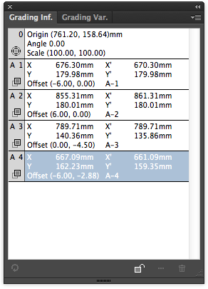
Grading Tools
To support the Grading tools there are two palettes; Grading Information and Grading Variable
Grading Information: This palette informs you of the corrections you have made, you can edit key information here too.
Grading Variable: This palette stores variable information such as measurements.

Slide 10
Grading Tools
The distance tool can be used for grading two points by the same distance, providing those two points follow a straight line, for example the width of a symmetrical pattern.
The point tool is used for grading points that need to move individually, for example, the strap

Slide 11
Grading Tools
How to use the Distance Revision tool:
Select both points that you would like to grade and increase the millimetre measurement by the total width grade or the total height grade.
Tick the box that makes the increase apply to both ends
How to use the Point Revision tool
Select the desired point and input the grade measurement in the X and/or Y axis, in the Move category.

Slide 12
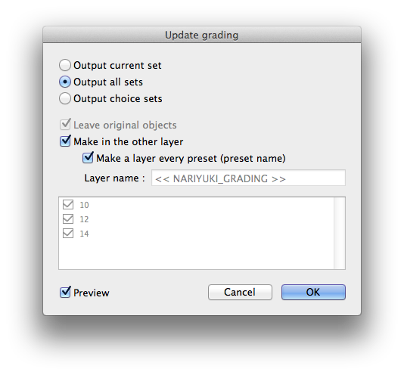
Grading Tools
You can also pre-set grade sizes and have grades produced automatically onto separate labelled layers.
This information can be transferred between different pattern documents.

Slide 13
Measuring: Grading Tools
Measurement tool
This tool allows you to measure the distance between two points as well as measure the length of a selected path.
All measurements are stored in the Grading Variable Palette.

Slide 14
Measuring: Segment Tools
Segment Tool
The first section of the Segment tool box allows you to have live feedback of a measurement of a selected or multiple selected paths.
These measurements aren’t remotely stored but can be annotated onto the pattern using the length comment tool.

Slide 15
DB Palette
The DB Palette (Database Palette) allows you to store patterns and blocks in a management file.
This allows you to input pre-existing patterns into the new documents including all their information.

Slide 16
Printing
Printing your patterns works in the same manner as all illustrator files.
File – Print – Print
Ensure the Scaling option is set to ‘Do Not Scale’
‘Media Size’ must be set to the same size as the original document

Slide 17
Combining with Illustrator Tools
The iPM plug-in tools are designed to aid the Illustrator software. You will still need to use all the illustrator tools and functions to complete tasks.
For example, adjusting the handles, moving and copying patterns are still controlled by the traditional Illustrator tools.
The iPM plug-in allows you to take the illustrator software one step further, providing more possibilities for product developers and technical designers.

Slide 18
iPM for Commercial Use
Allows you to open and read your commercial patterns from factories
Visualise and alter the patterns
Modify shapes
Check grades
Or draft and grade your patterns from scratch and send them over to factories

